Slide 1
Web Application Development ISCG7420 Introduction to Web Development
School of Computing, Electrical and Applied Technology

Slide 2
Outlines
Object–relational Mapping
Object-relational Mappers
Python Object-relational Mappers
Python Web Frameworks

Slide 3
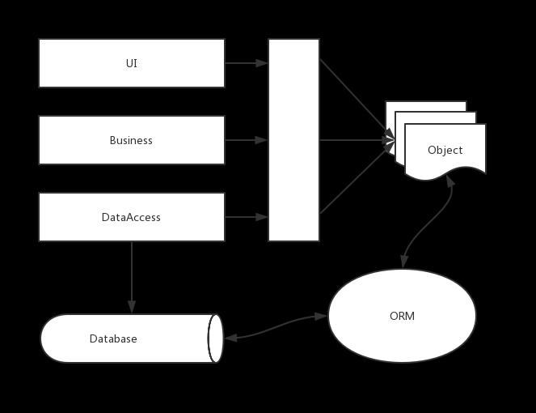
Object–relational mapping

Slide 4
Object–relational mapping
A technique for storing, retrieving, updating, and deleting from an object-oriented program in a relational database.
Utilizers a “data layer” to manage translation between the OO and relational
The data layer is typically a library written in the OO language that is part of, or works in conjunction with your web framework.

Slide 5
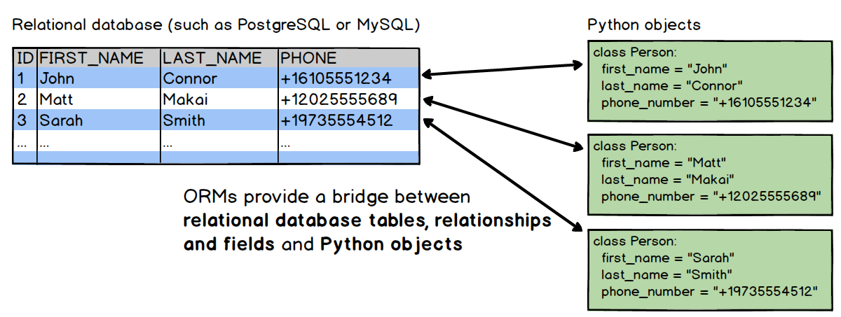
Object relationship and Structure database

Slide 6
List of object–relational mapping software
https://en.wikipedia.org/wiki/List_of_object%E2%80%93relational_mapping_software

Slide 7
ORM – Advantages
Hide the details of data access
Easy to construct a solidified data structure
Reuse code
Tested functions

Slide 8
ORM – Disadvantages
Loss in developer productivity whilst they learn to program with ORM.
Developers lose understanding of what the code is actually doing - the developer is more in control using SQL.
ORM has a tendency to be slow.
ORM fail to compete against SQL queries for complex queries.

Slide 9
Object-relational Mappers
A code library that automates the transfer of data stored in relational database tables into objects that are more commonly used in application code.
Provides a high-level abstraction upon a relational database that allows a developer to write Python code instead of SQL to create, read, update and delete data and schemas in their database.

Slide 10
Exercise
Search Object-relational mappers for
Java
Python
C#
.NET Framework

Slide 11
Python Object-relational Mappers
SQLAlchemy
Django
SQLObject
Storm

Slide 12
SQLAlchemy
https://www.sqlalchemy.org/
Python SQL toolkit and Object Relational Mapper that gives application developers the full power and flexibility of SQL.

Slide 13
Django
https://www.djangoproject.com/
Django is a high-level Python Web framework that encourages rapid development and clean, pragmatic design. Built by experienced developers, it takes care of much of the hassle of Web development, so you can focus on writing your app without needing to reinvent the wheel. It’s free and open source.

Slide 14
SQLObject
http://www.sqlobject.org/
SQLObject is a popular Object Relational Manager for providing an object interface to your database, with tables as classes, rows as instances, and columns as attributes.
SQLObject includes a Python-object-based query language that makes SQL more abstract, and provides substantial database independence for applications.

Slide 15
Storm
https://storm.canonical.com/
Storm is an object-relational mapper (ORM) for Python developed at Canonical. The project was in development for more than a year for use in Canonical projects such as Launchpad and Landscape before being released as free software on July 9th, 2007.

Slide 16
Python database connectors
https://wiki.python.org/moin/DatabaseInterfaces

Slide 17
Python Web Frameworks
https://wiki.python.org/moin/WebFrameworks#Popular_Full-Stack_Frameworks

Slide 18
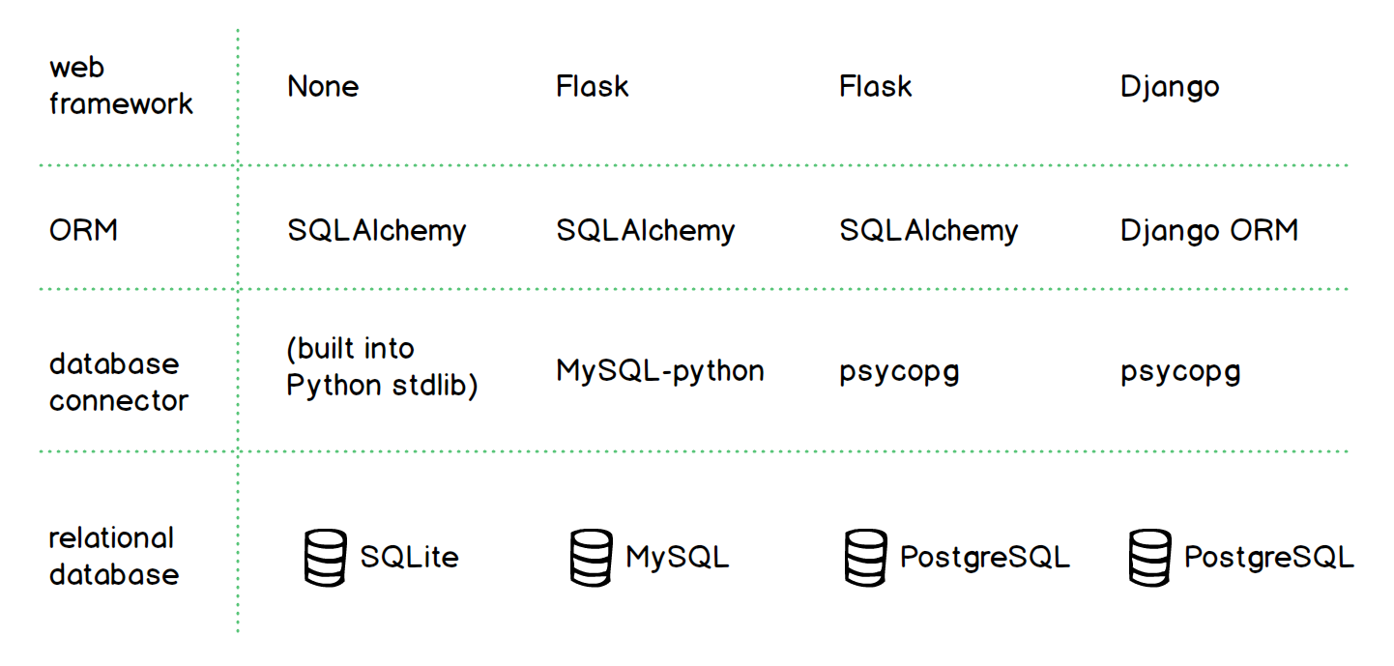
ORM in Flask & Django

Slide 19
Resoures
https://www.programmersought.com/article/1452823853/
https://stackoverflow.com/questions/4667906/the-advantages-and-disadvantages-of-using-orm

